Slide 1
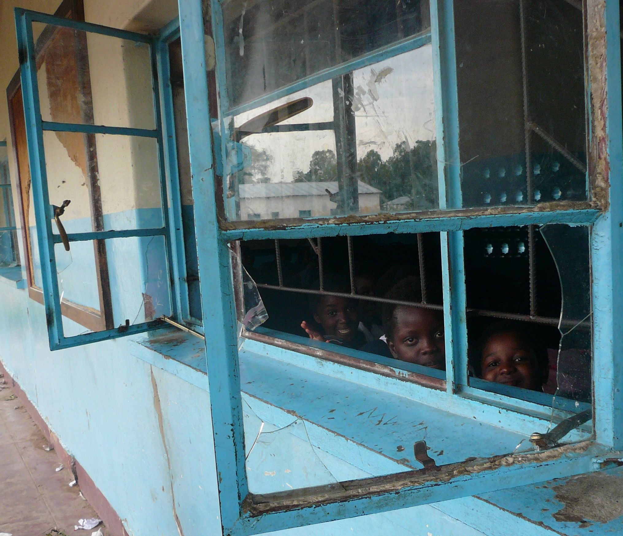
School in Mwandi
On the outside looking in.

Slide 2
As you enter the village of Mwandi, this sign is at the entrance.

Slide 3
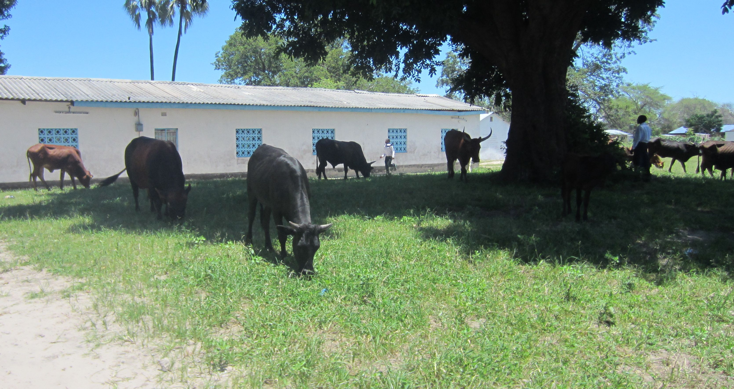
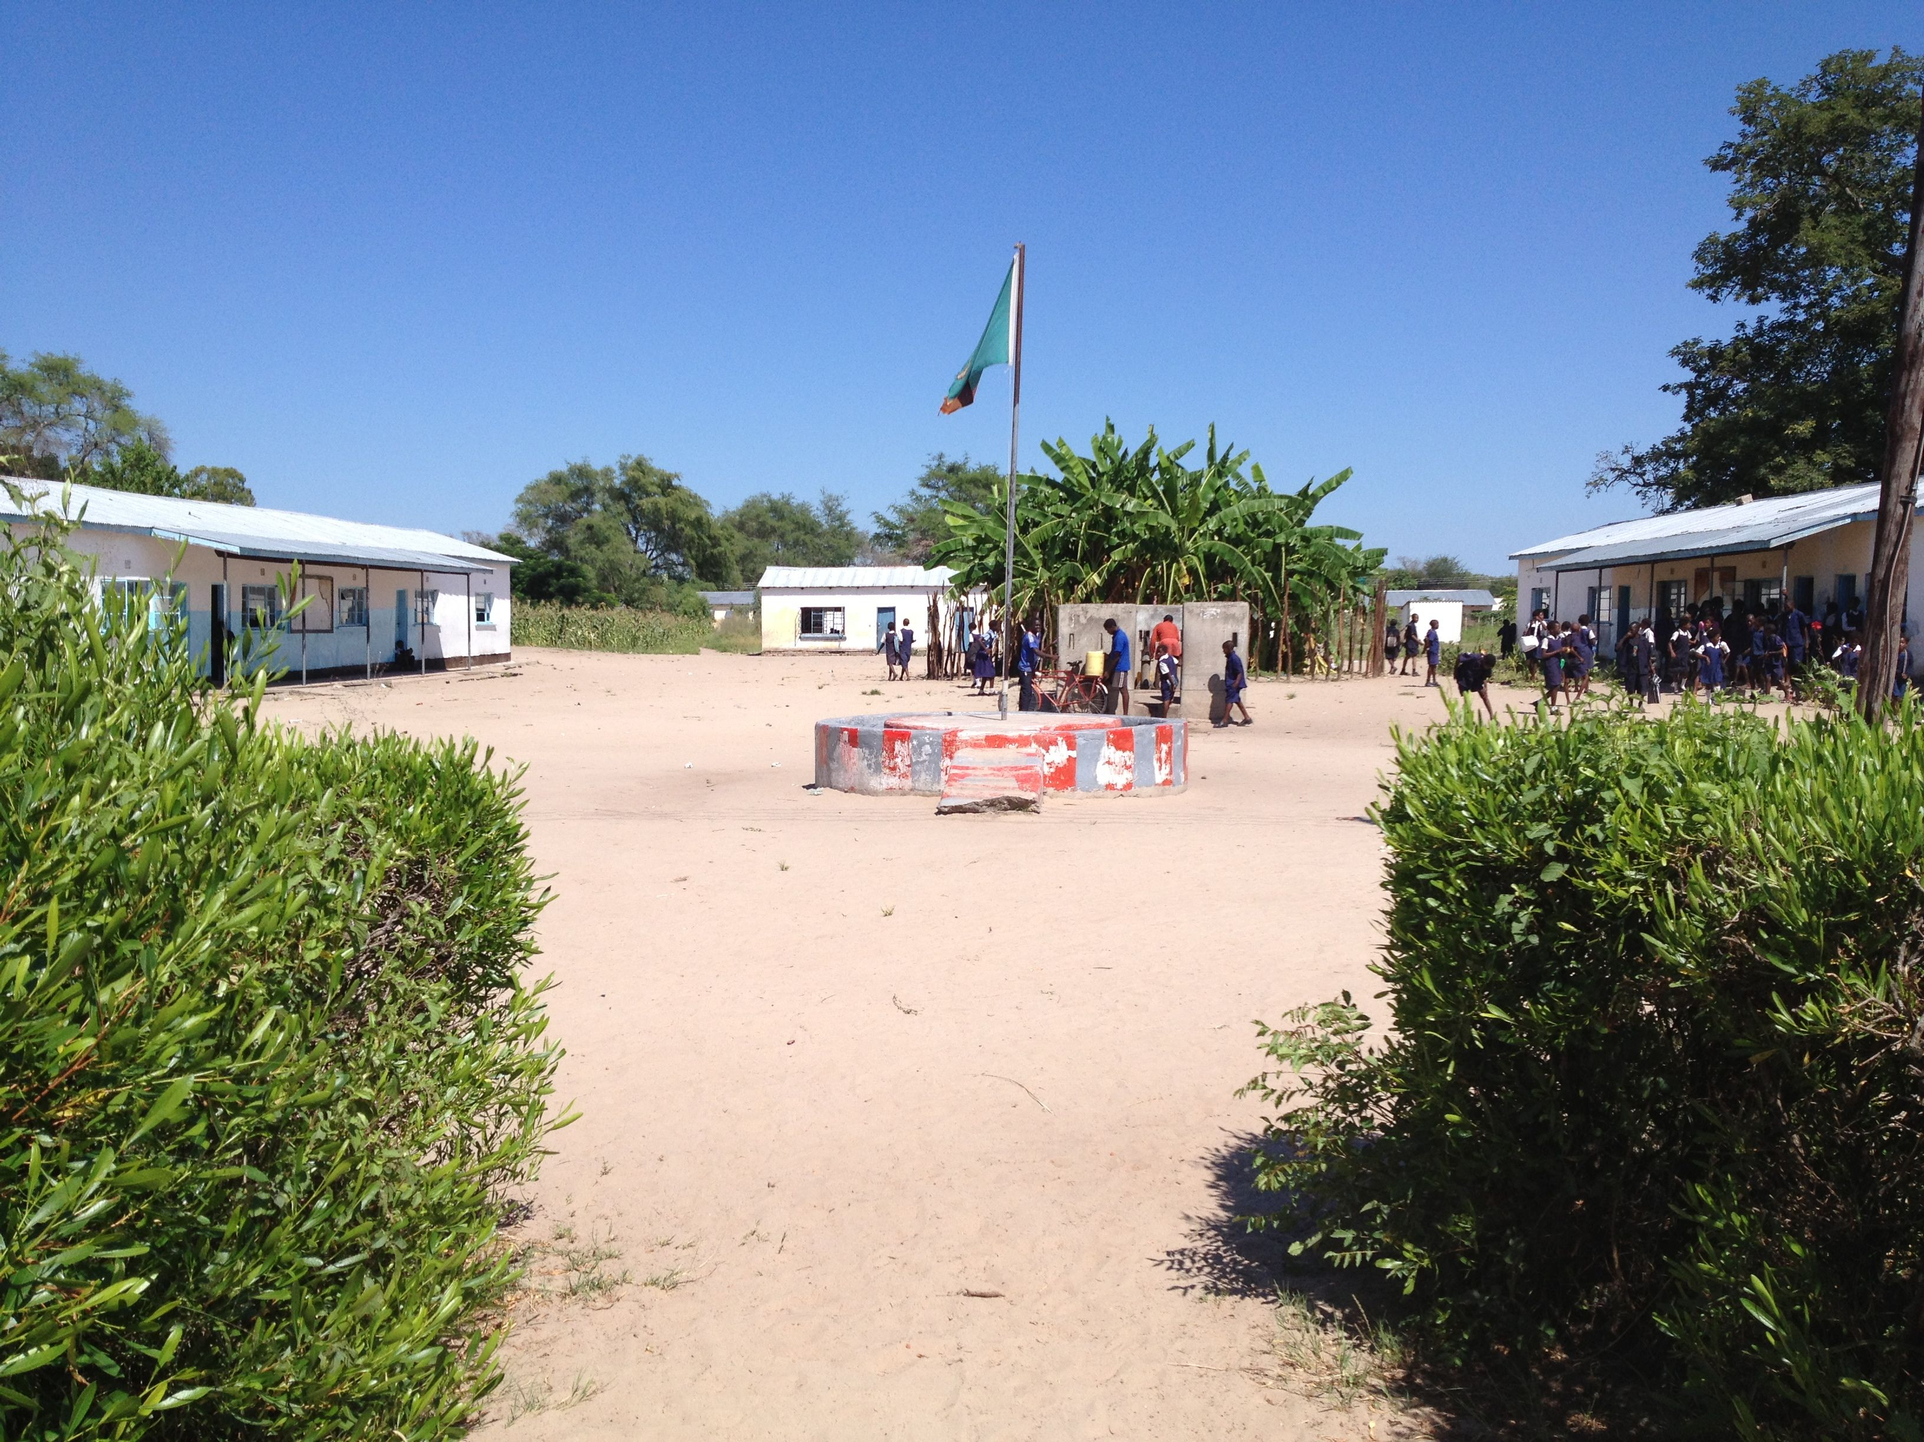
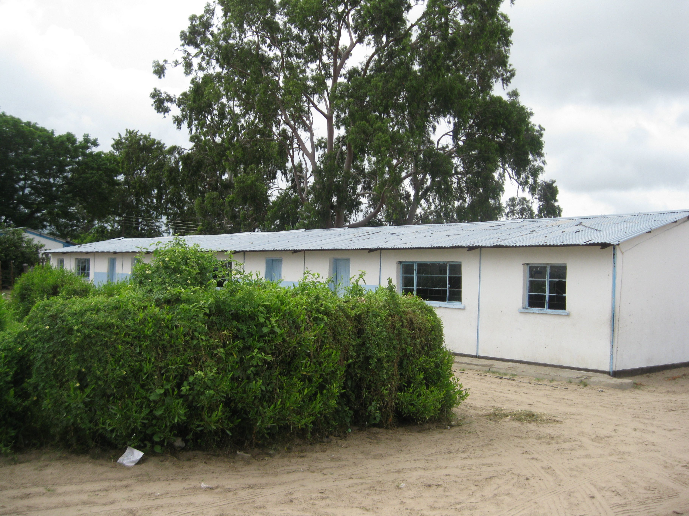
The Buildings at the Basic School…and cows!

Slide 4
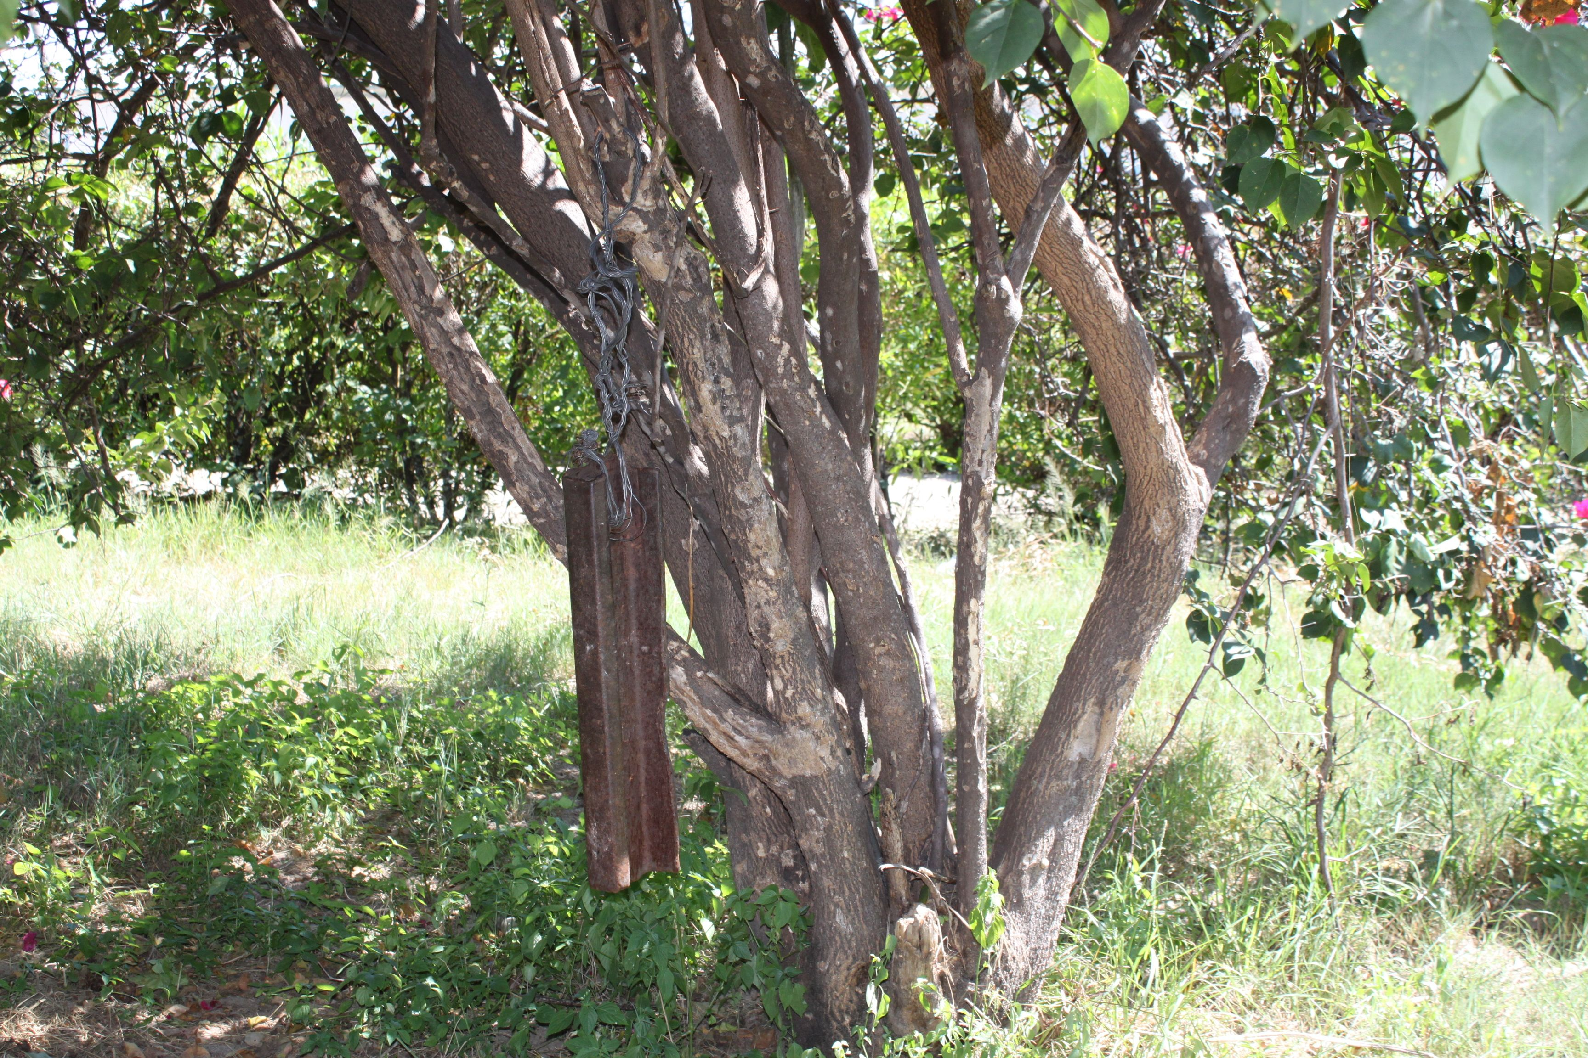
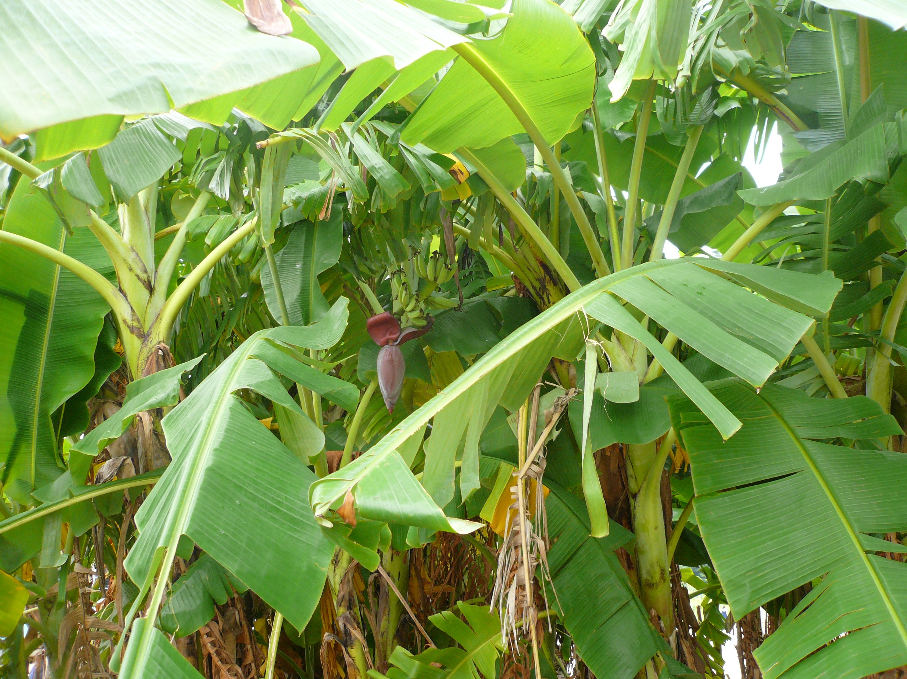
Bells, bananas and bats
The bell!!

Slide 5
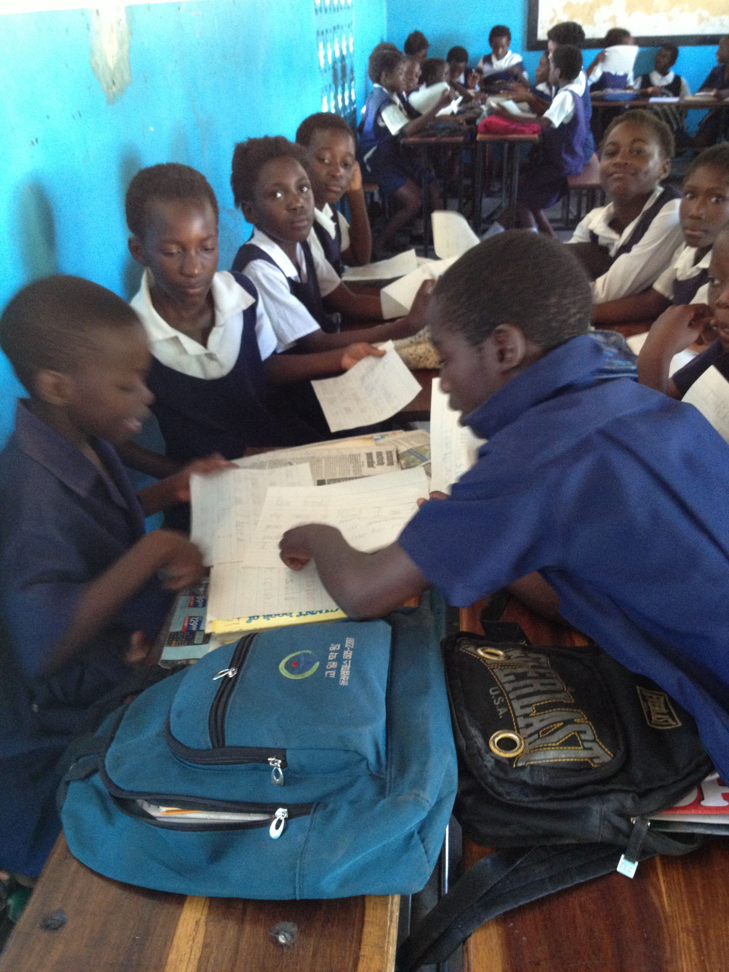
Basic school students… 5th graders

Slide 6
6th graders writing letters

Slide 7
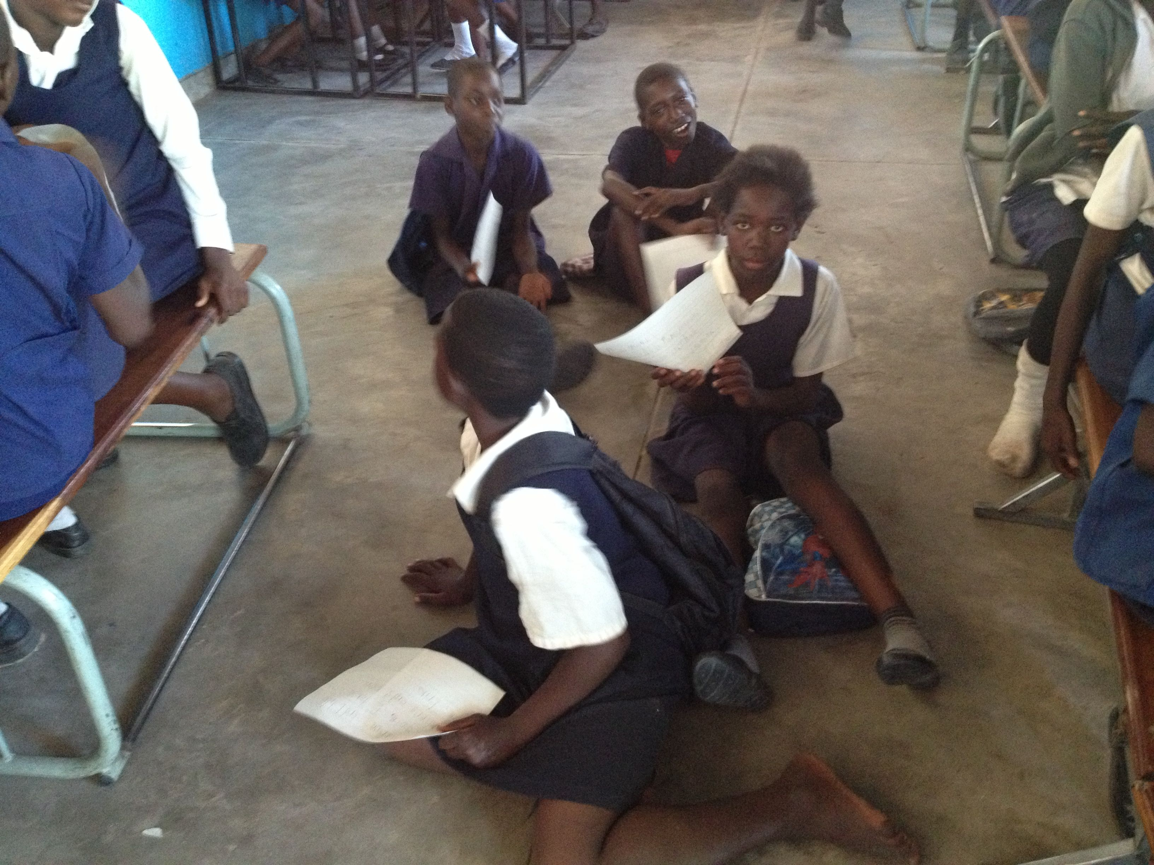
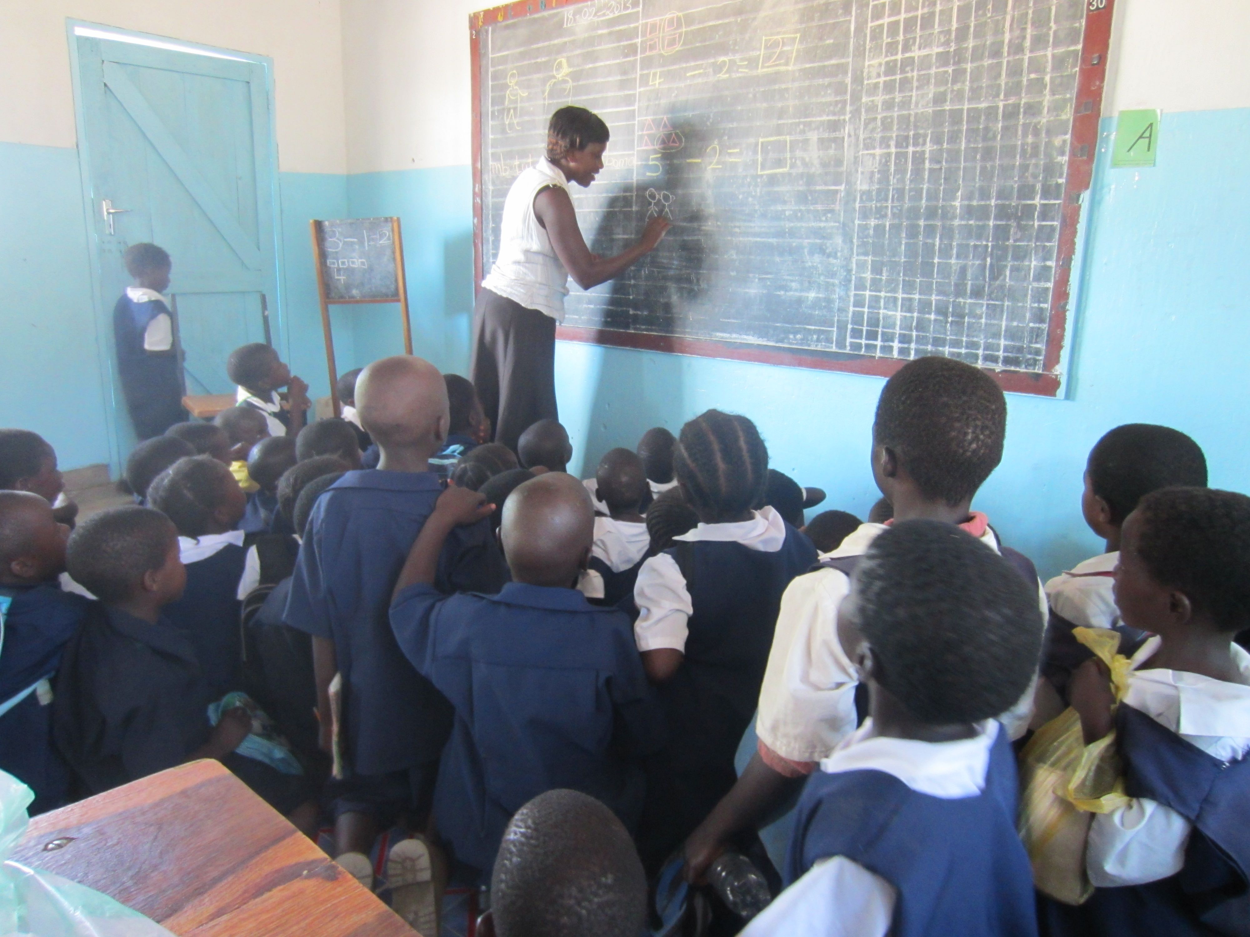
Cramped, crowded classrooms

Slide 8
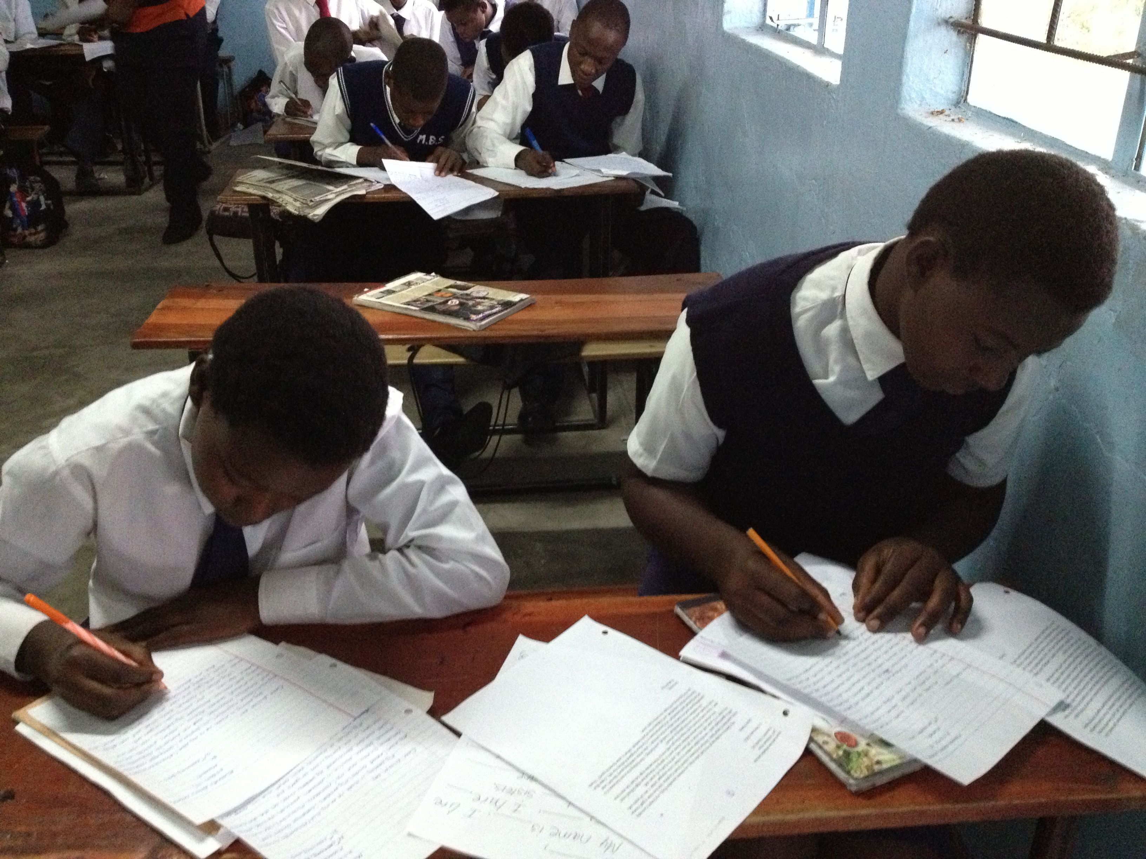
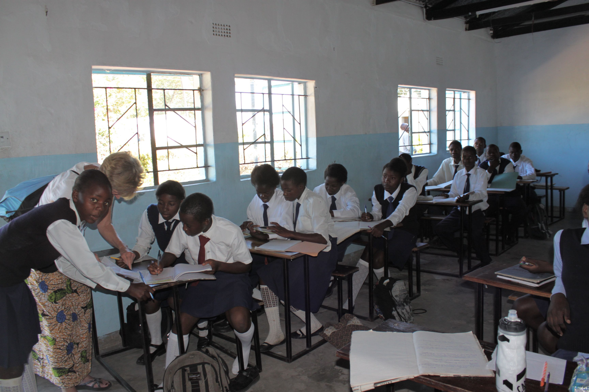
Writing letters in lots of different classrooms… a very meaningful, exciting, and real task for these students.

Slide 9
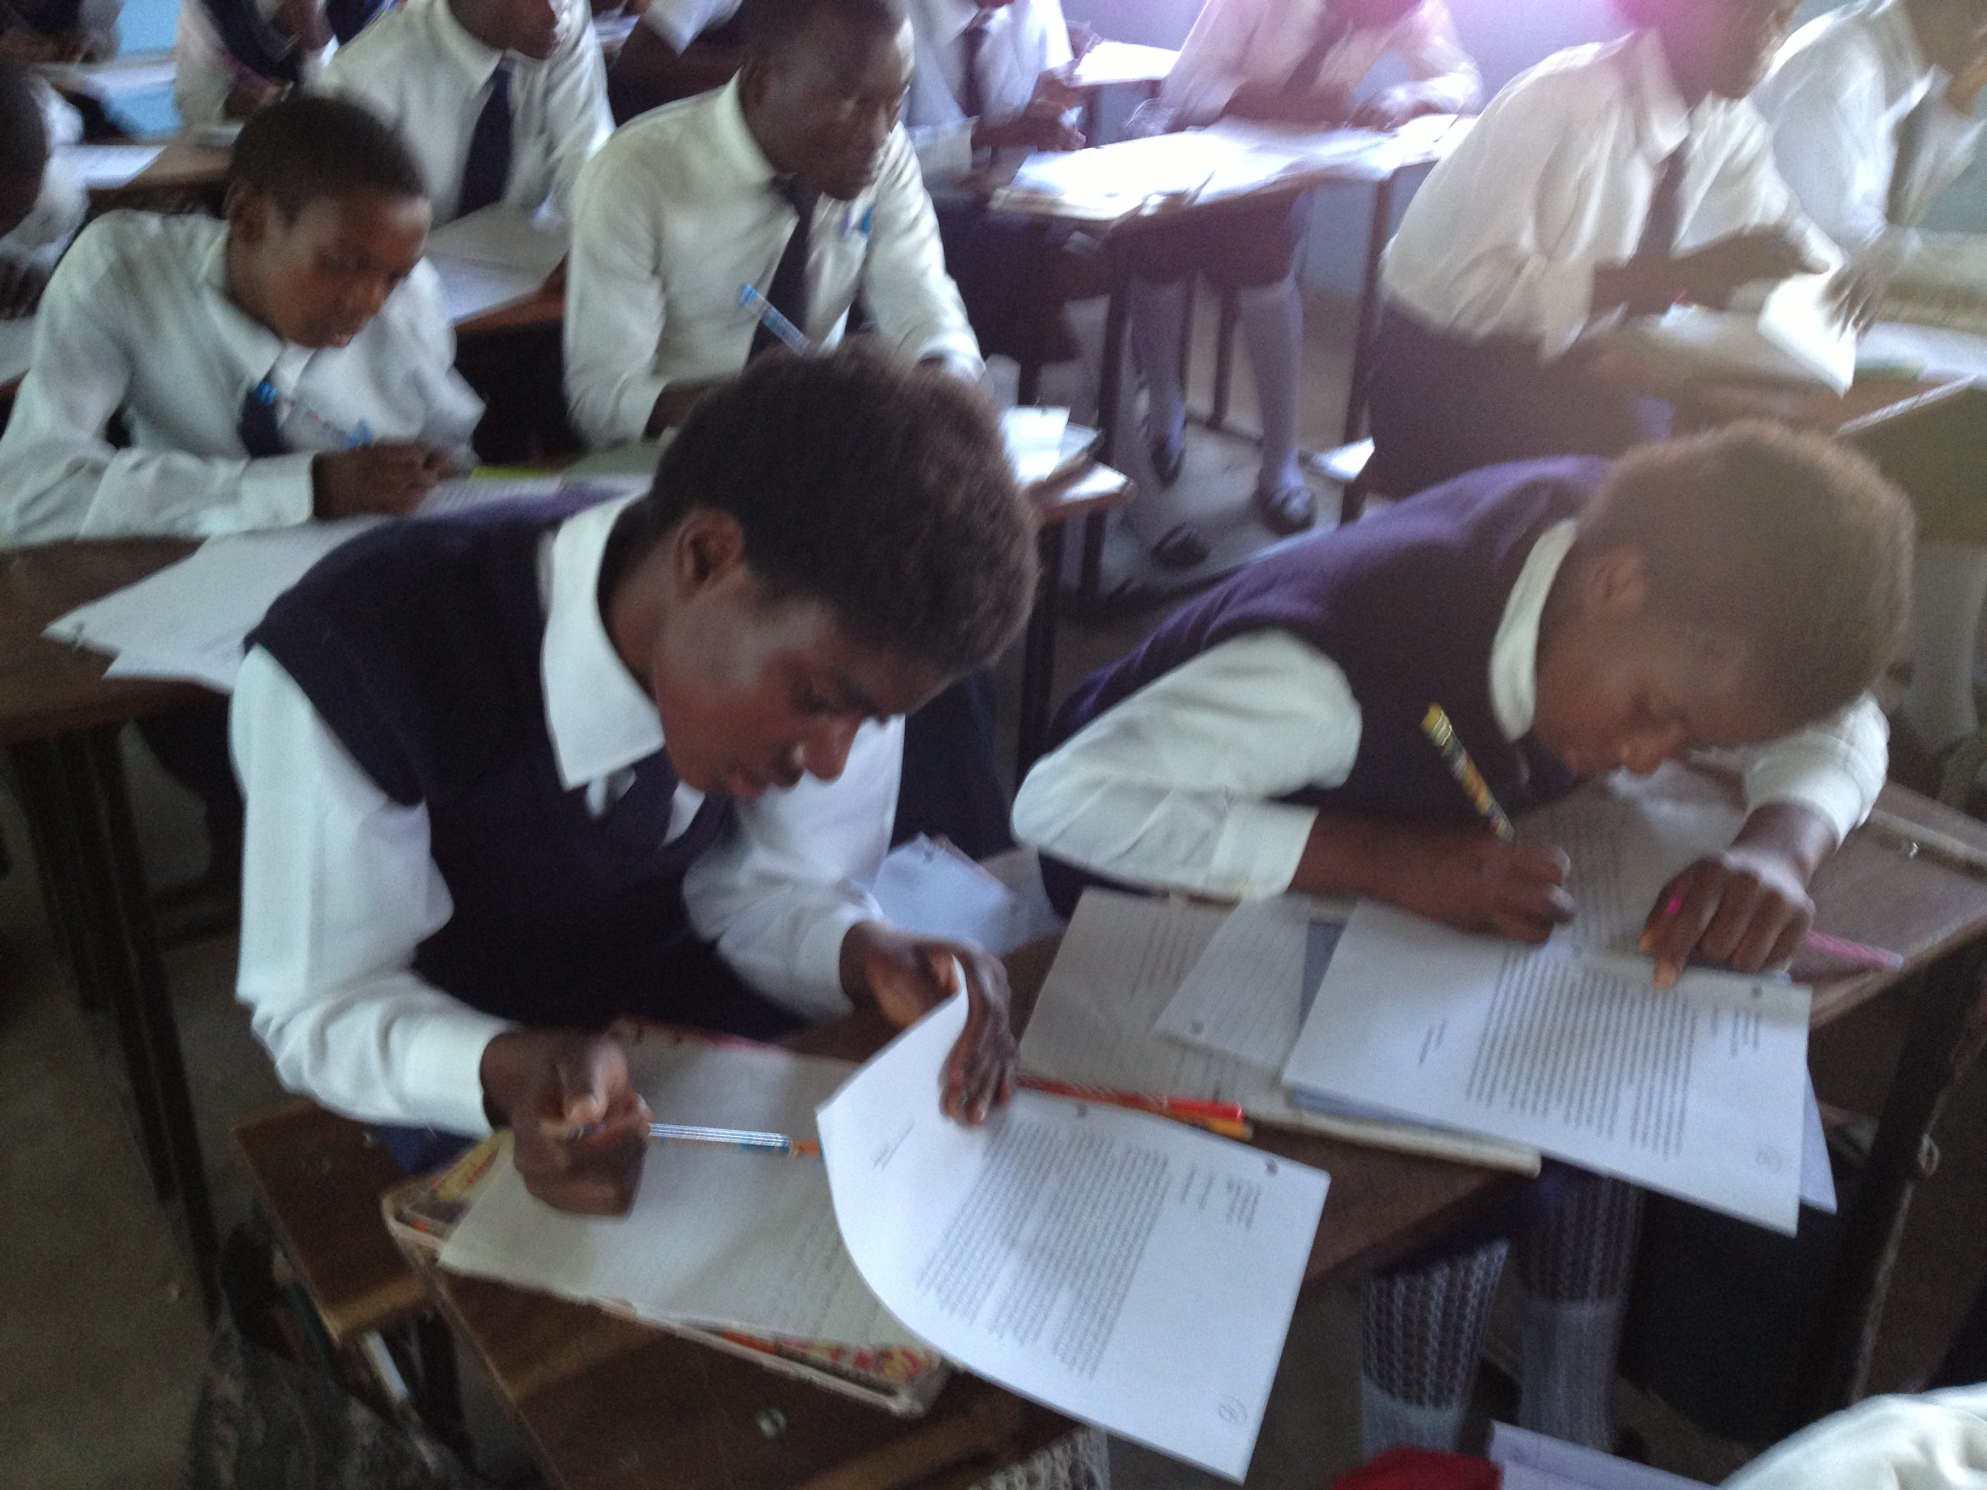
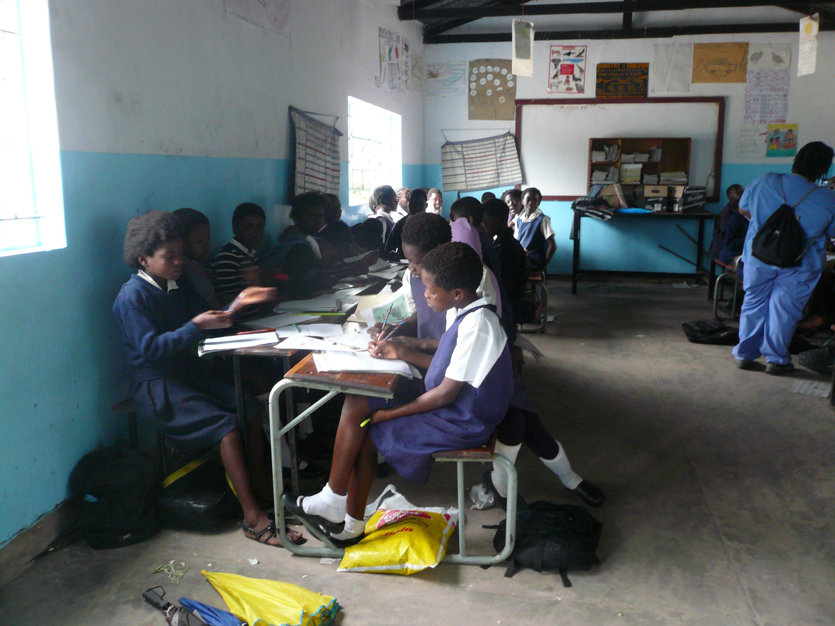
Writing responses to letters was a serious task for the Mwandi students.

Slide 10
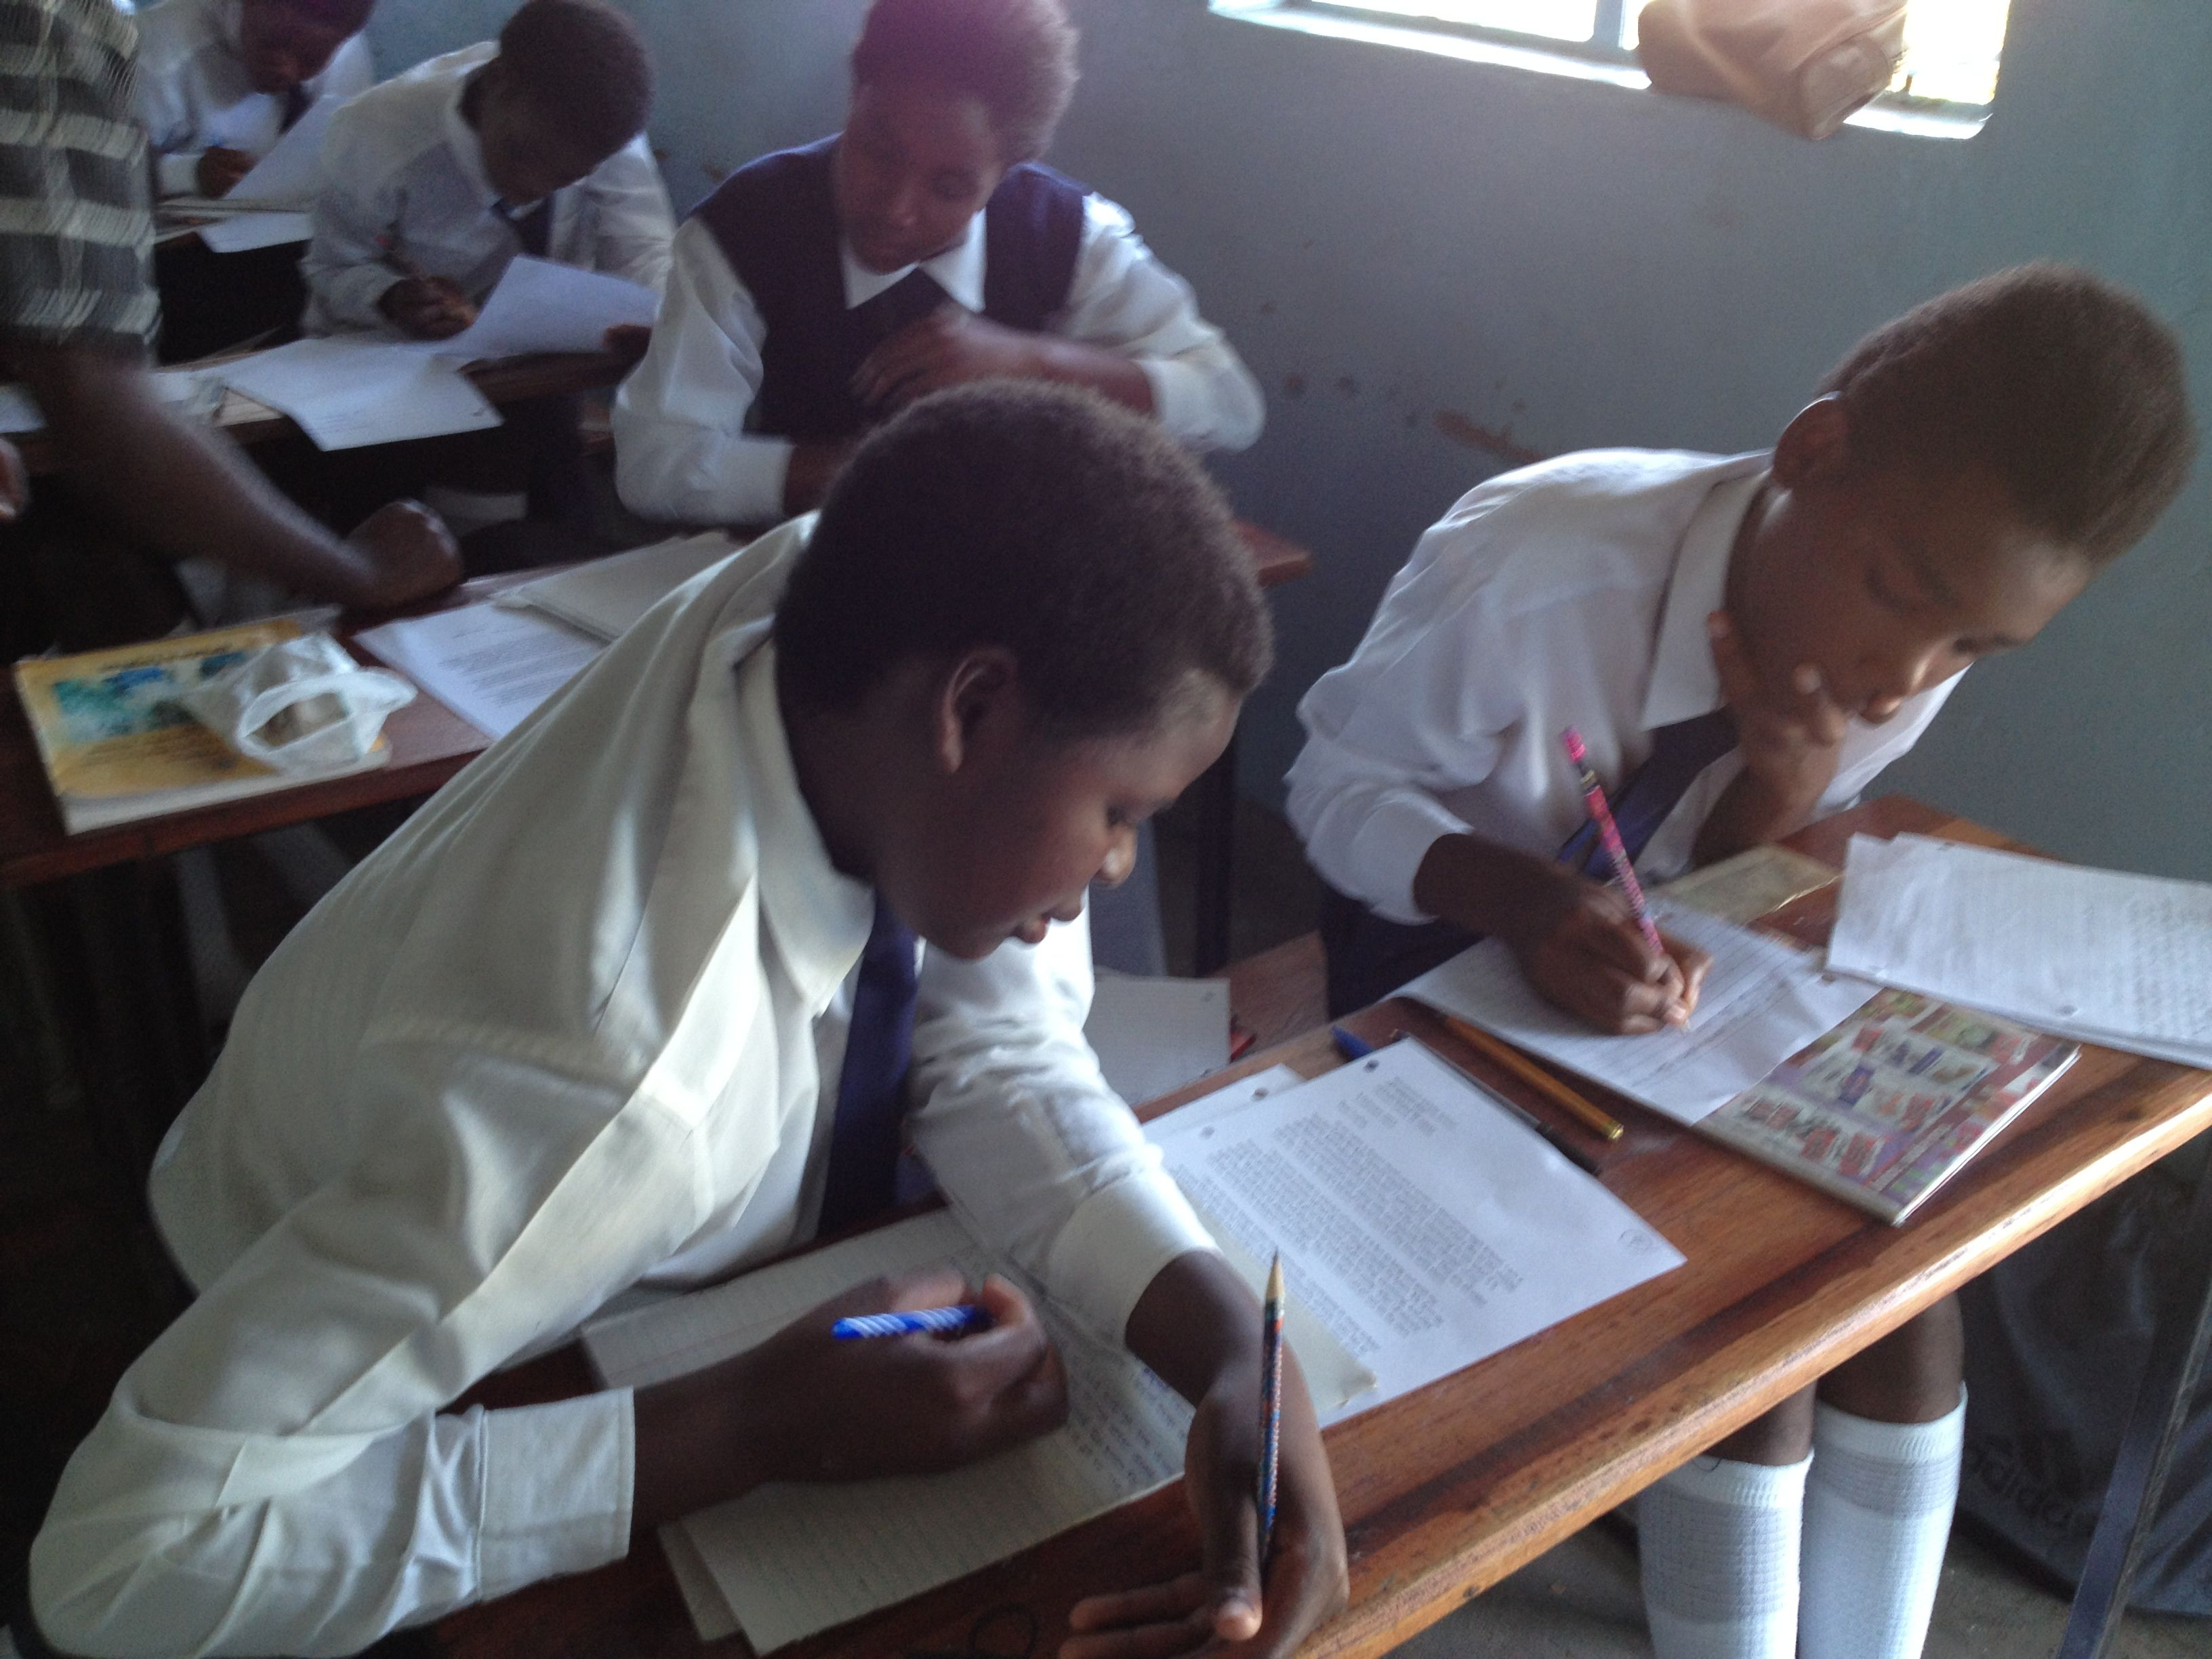

Slide 12
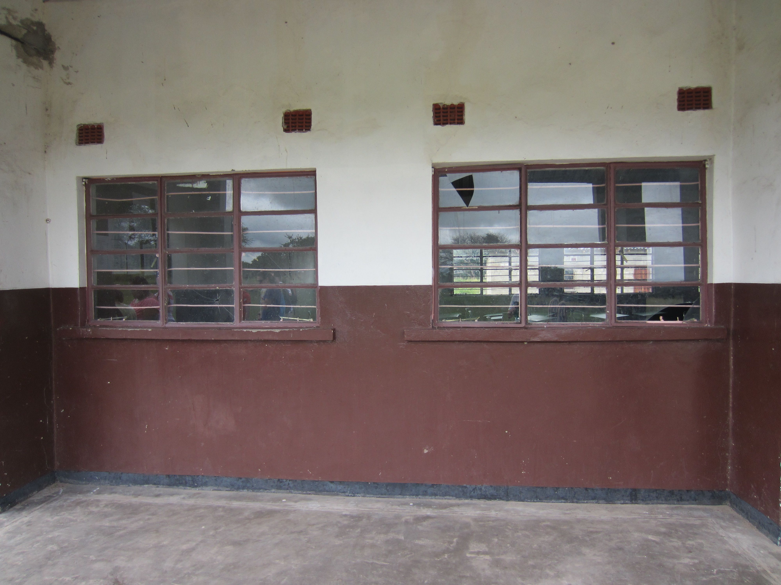
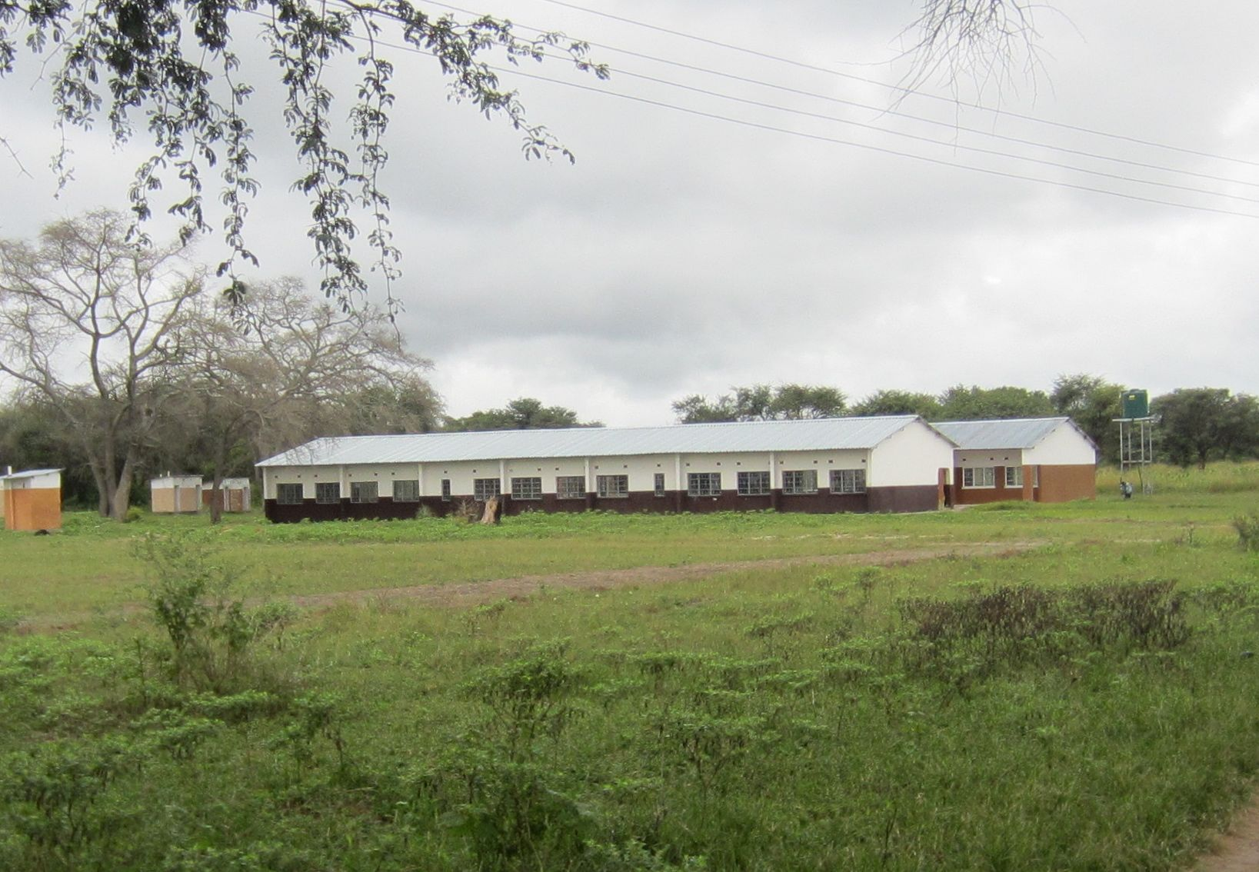
The High School, grades 10-12

Slide 13
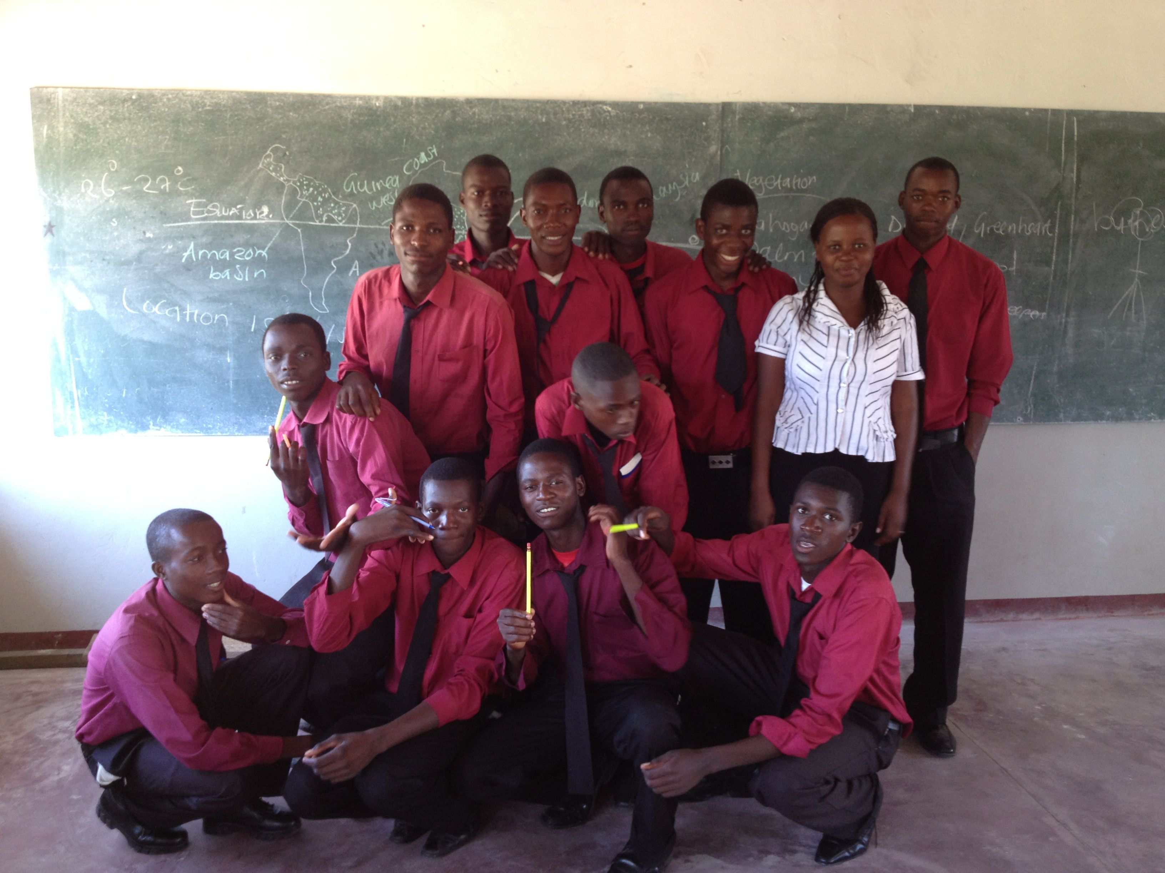
High School Geography
If you want a map…you have to draw it on the board! This is the student who drew it for the teacher.
The boys and their pencils!

Slide 14
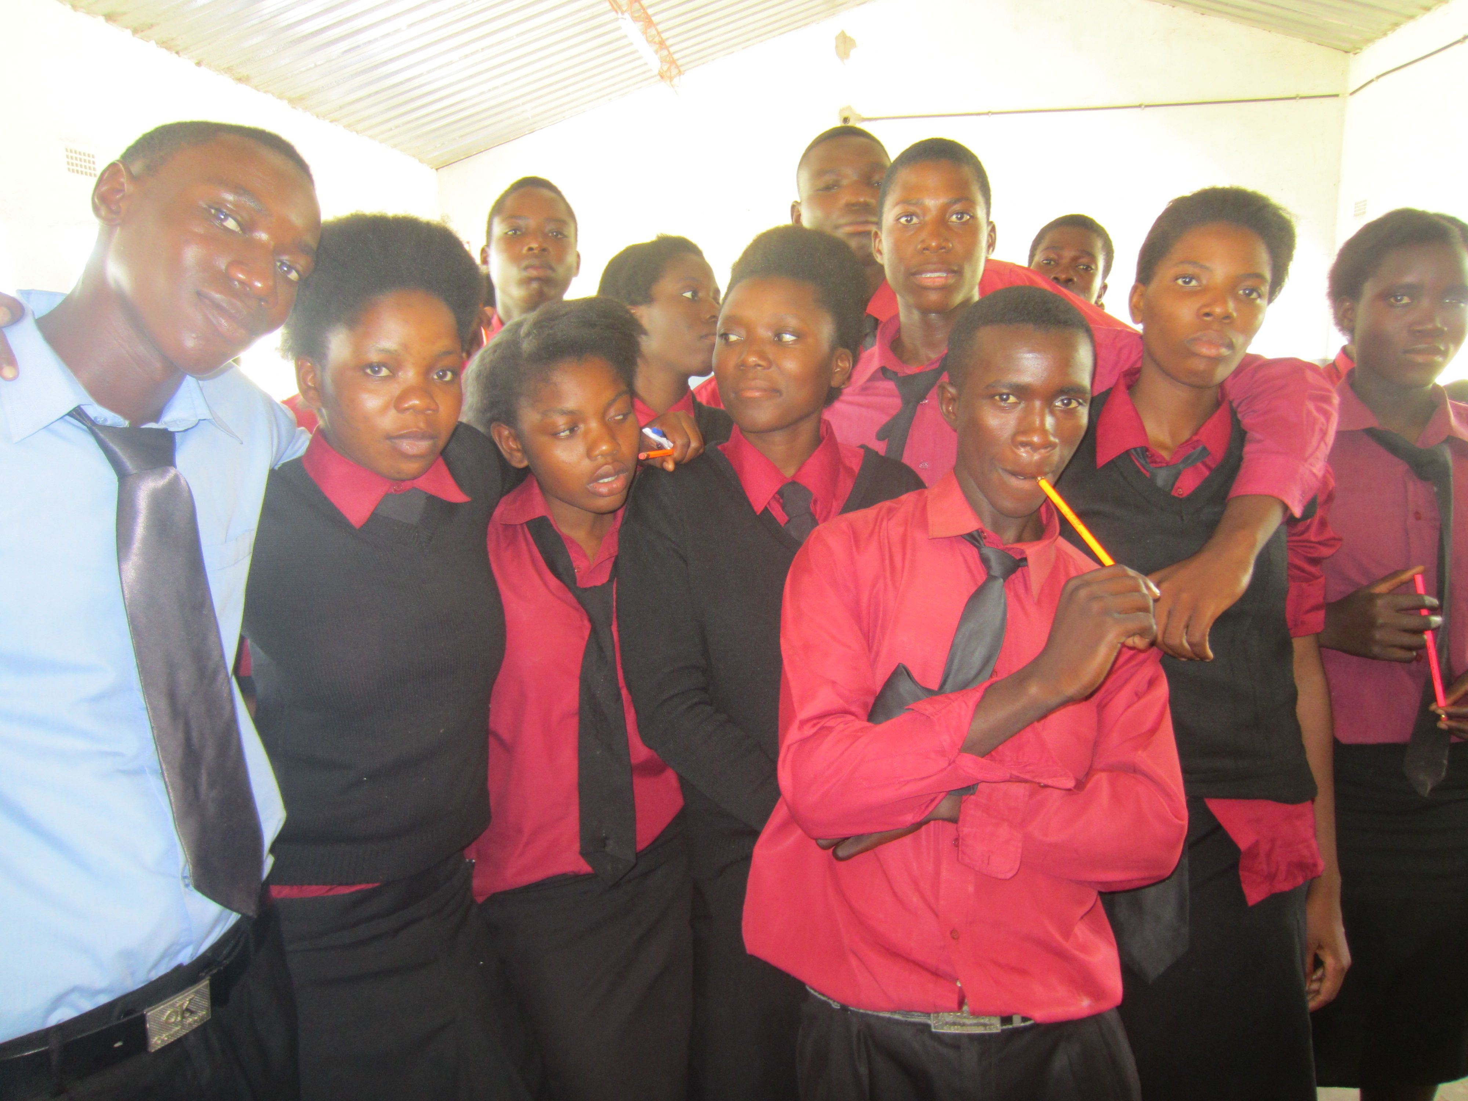
Amazing how much one little pencil can mean!!
High school students shouted with glee and “blessings” when they were given new pencils.

Slide 15
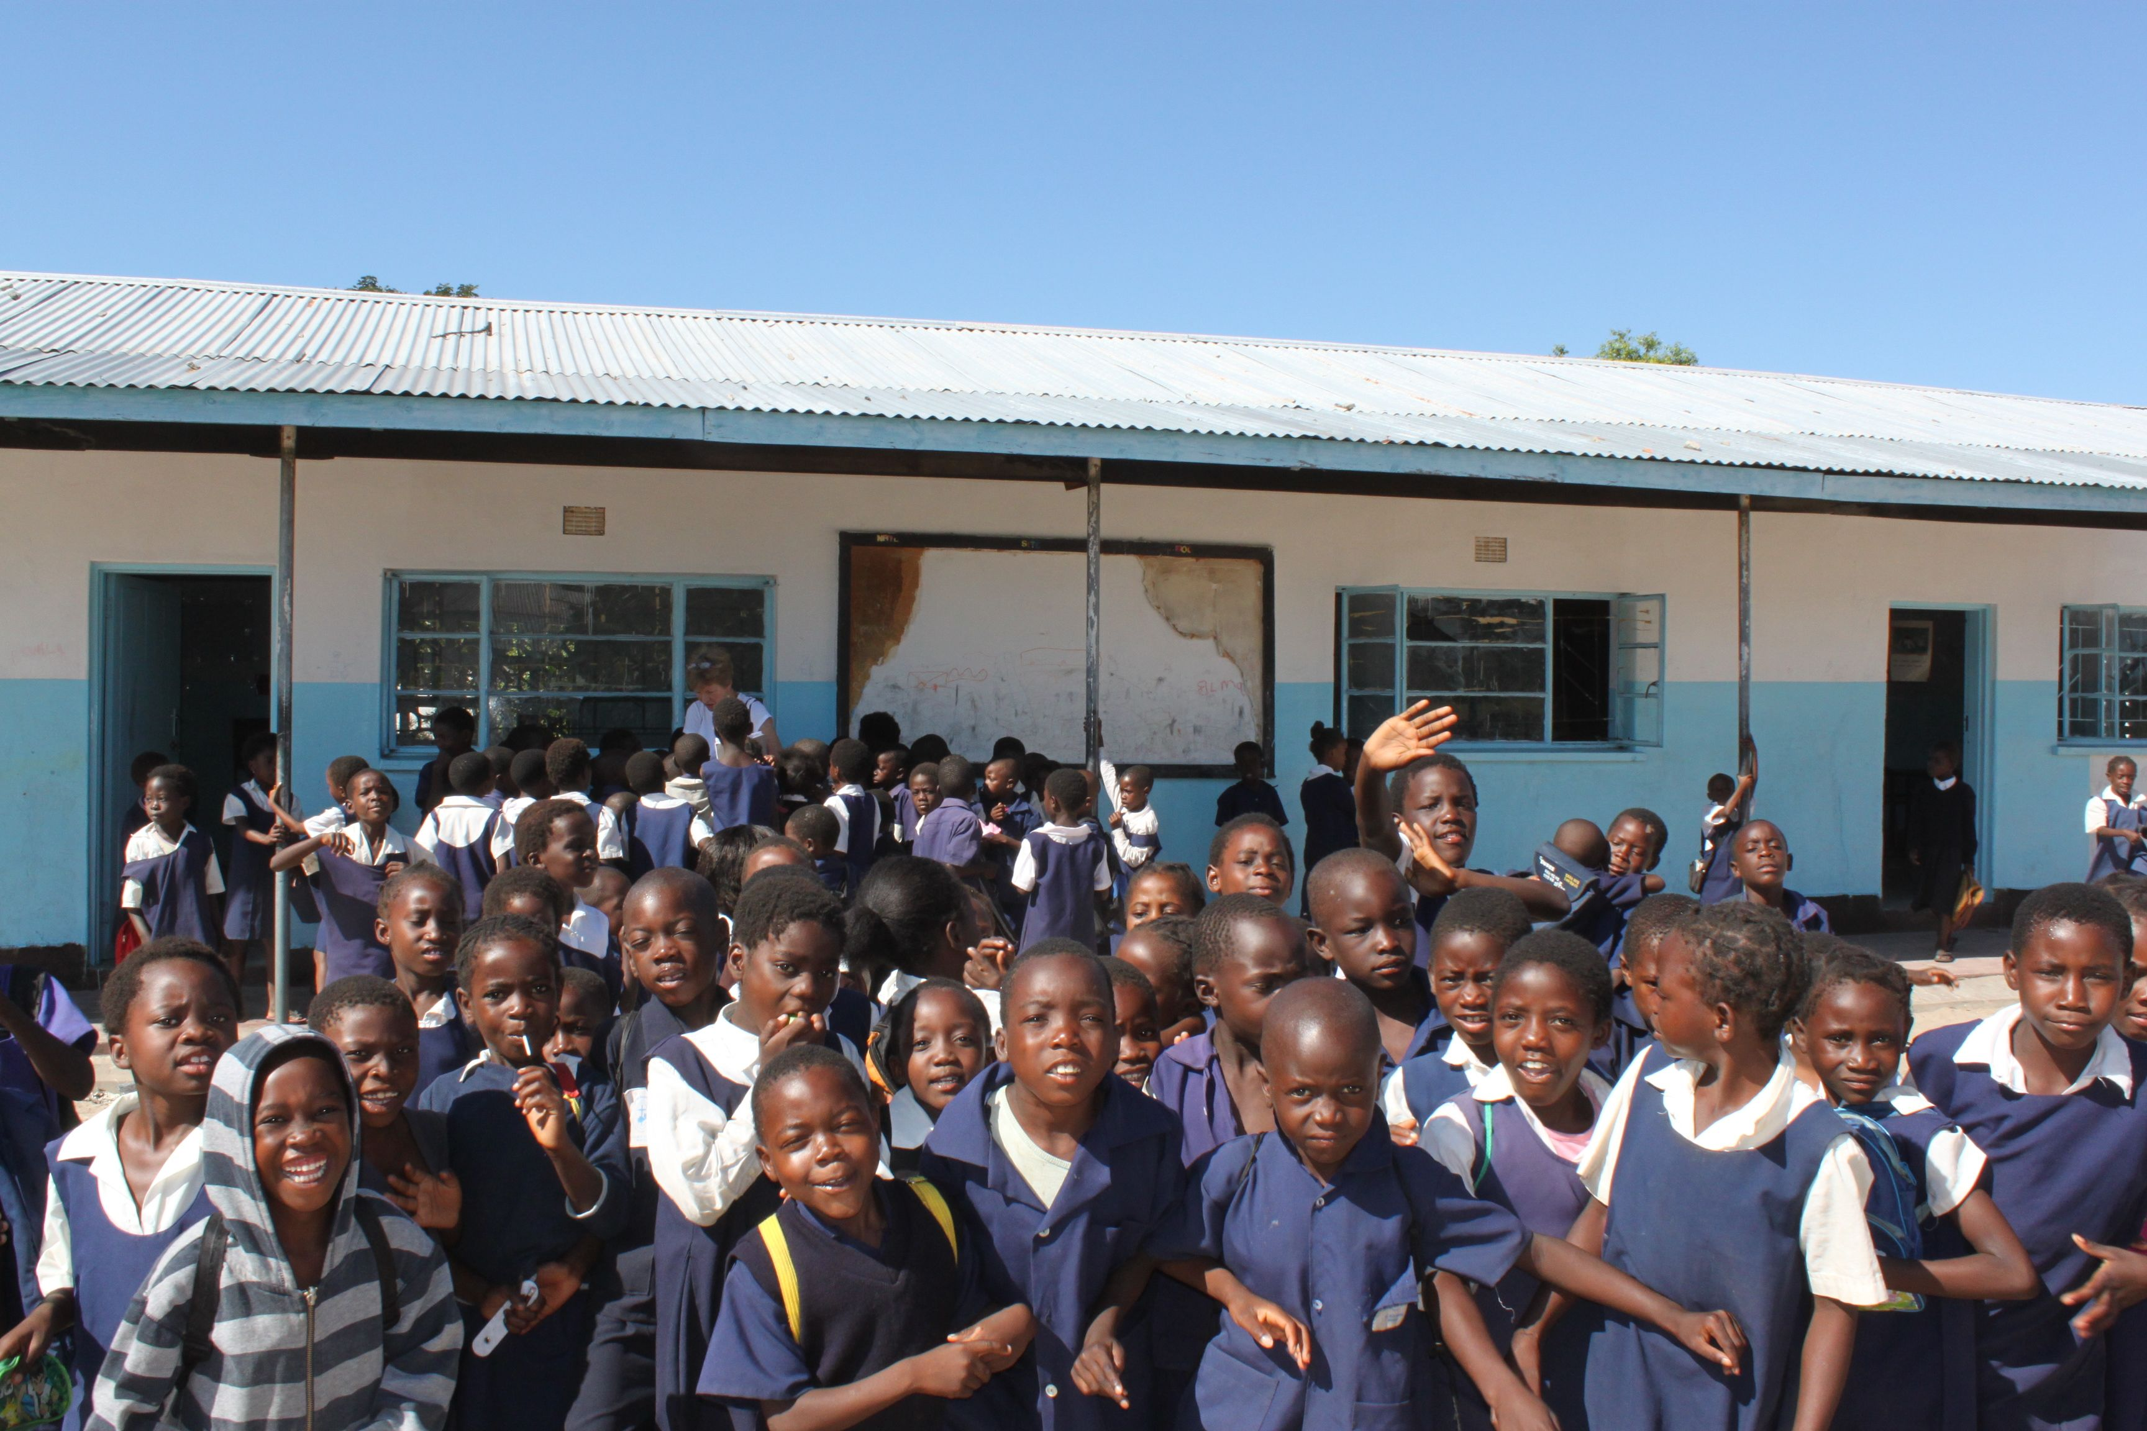
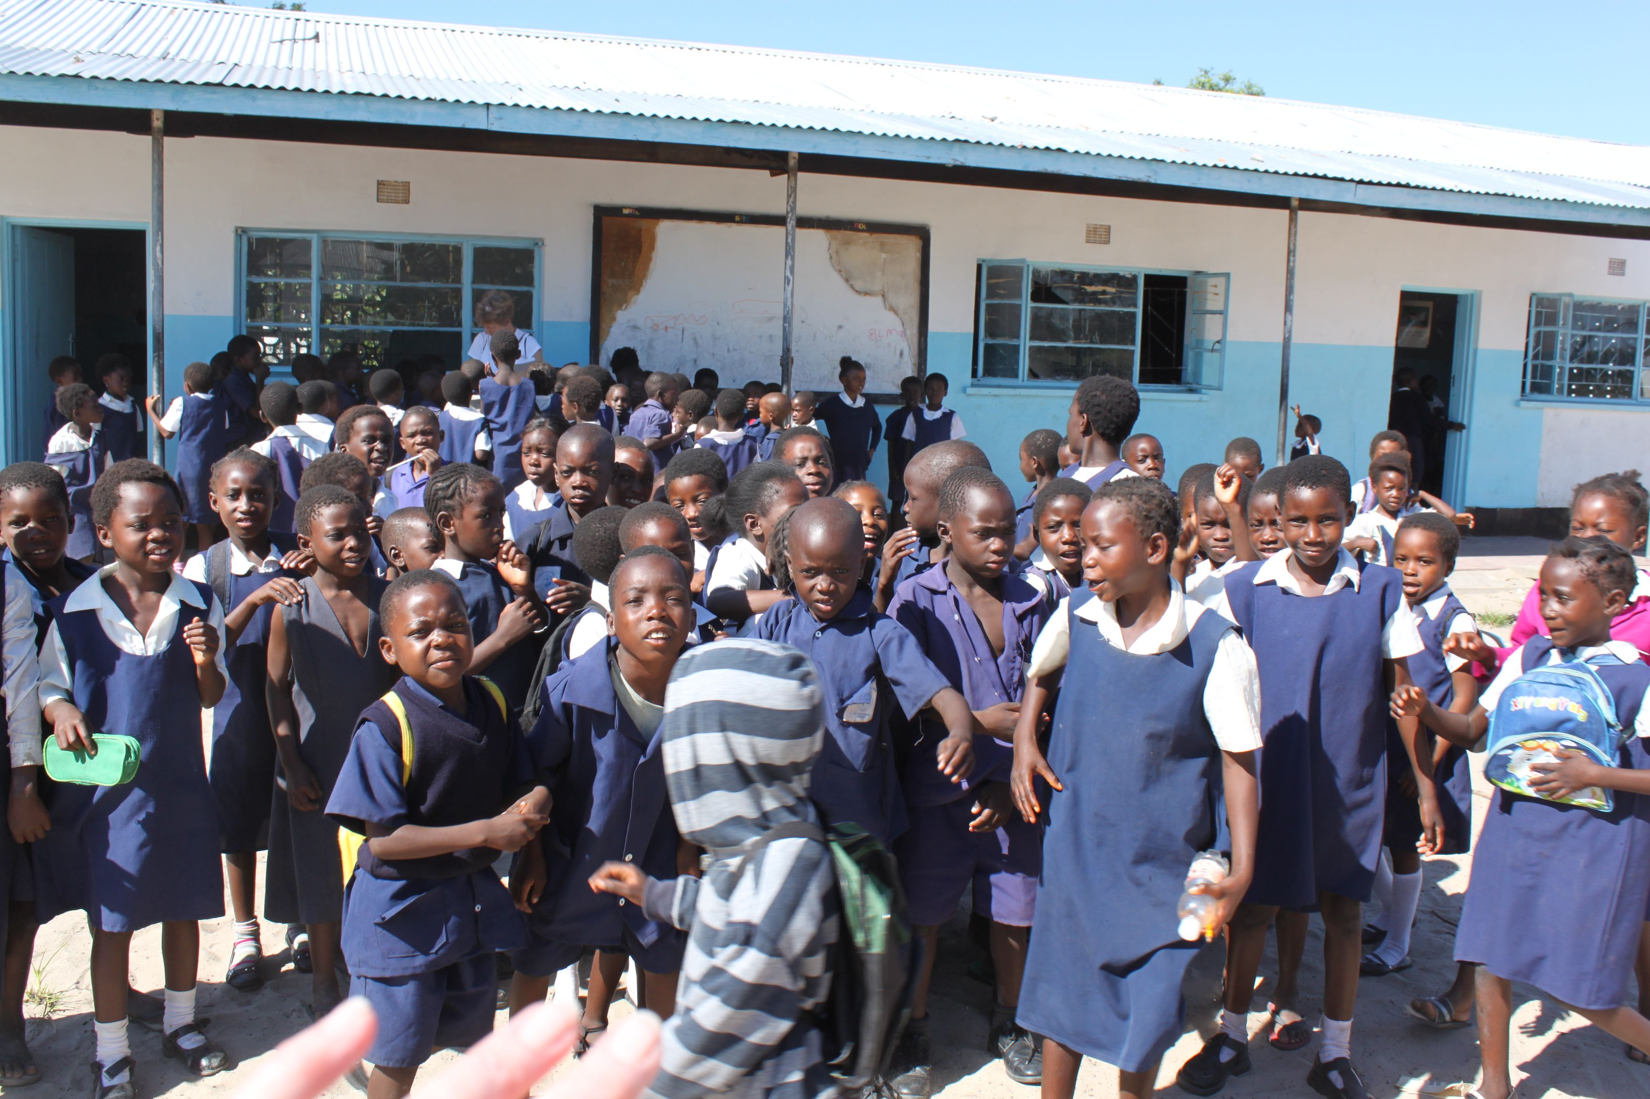
Everyone wanted to have a pencil!!

Slide 16
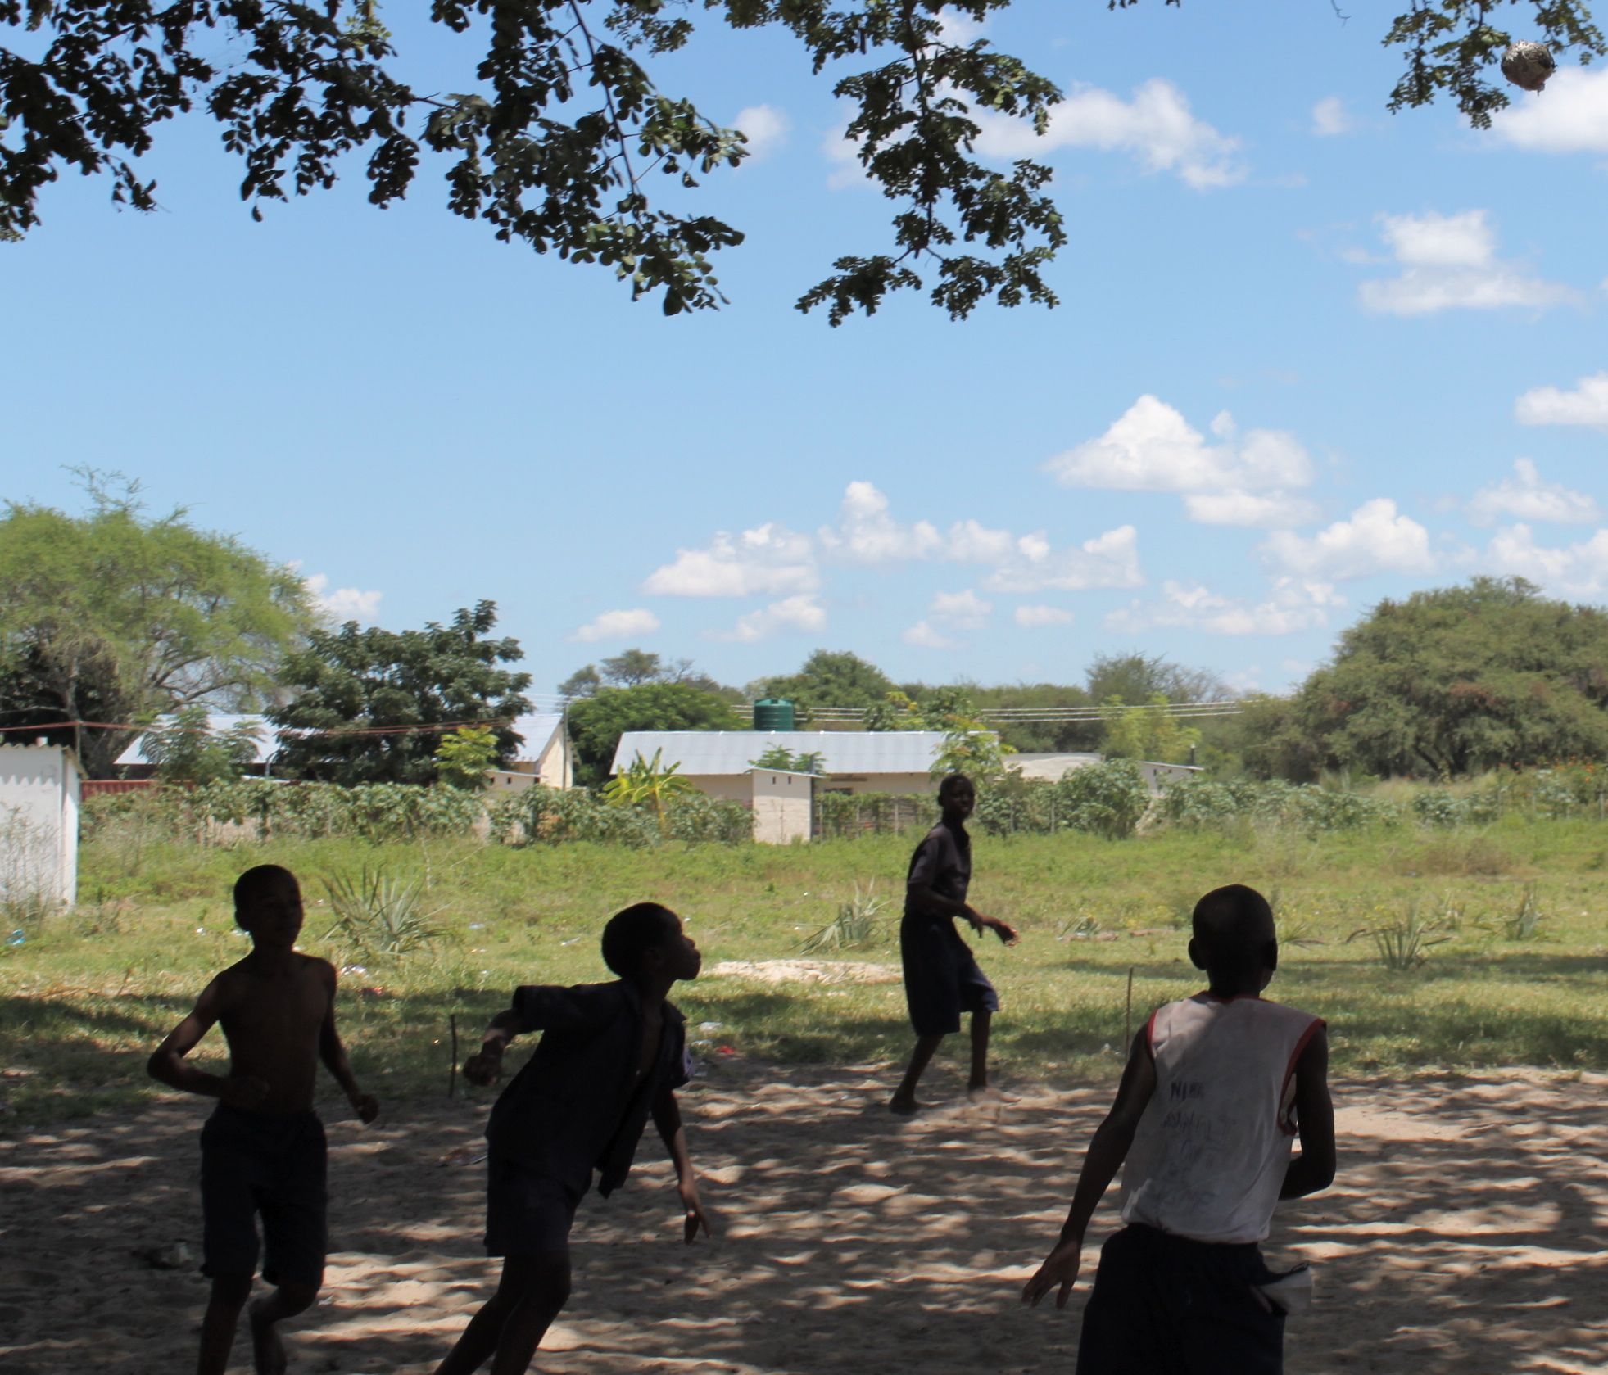
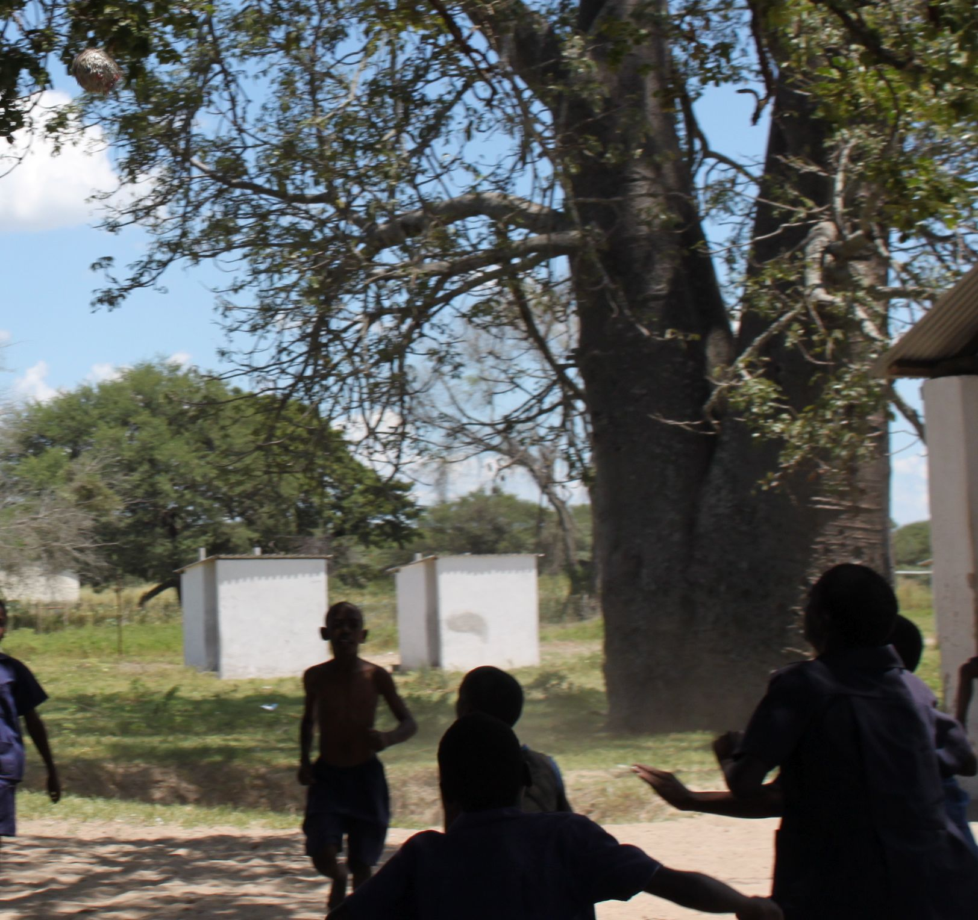
Soccer was a favorite before, during and after school. See the ball???

Slide 17
Home-made ball using string and plastic bags!

Slide 18
Preparing for field day!
All of the children had to get one or two bags of shavings to use for the track and events on field day!

